Slide 1
JAM_A_PC - Acebook
Developers: Aaron Harris, Cristiano Silva, Peter Dyson, Mark Robins
Quality Engineers: Joao Fernandes, Adam Little

Slide 2
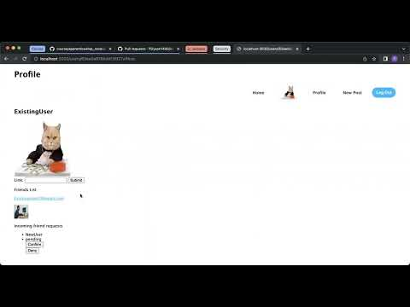

Slide 3

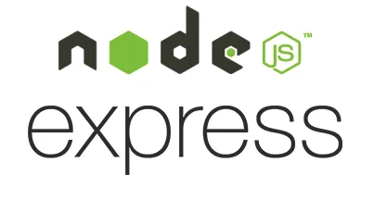








Technologies used
JavaScript as a language
Express web framework for Node.js.
Nodemon to reload the server automatically.
Handlebars to render view templates.
Mongoose to model objects in MongoDB.
ESLint for linting.
Jest for unit testing.
Cypress for end-to-end testing.
Render and Atlas MongoDB.
Tableplus

Slide 4
Week 1
Initial Setup
Trello board setup
Rules processes and agreements
Initial diagram
Initial exploratory test
Documentation
Setting up Cypress test suite and config files for the test database
Further test writing
Mid point ‘quality’ discussions
Mid point exploratory tests
Tuesday
Thursday
Monday
Wednesday
Friday
Created Test plan
Set up CI pipeline
Documentation
Finished Cypress suite setup
End to end testing
Integration testing

Slide 5
Week 2
Midpoint retro with coaches
Exploratory testing
Test planning
Documentation
Added CD to CICD pipeline by setting up the product on Render
Further testing and exploratory feature testing
Demo day
Tuesday
Thursday
Monday
Wednesday
Friday
Feature testing
Exploratory testing
Reflective session on ‘adding quality and value’
Final exploratory session
Accessibility and security tests
Documentation
Demo preparation

Slide 6
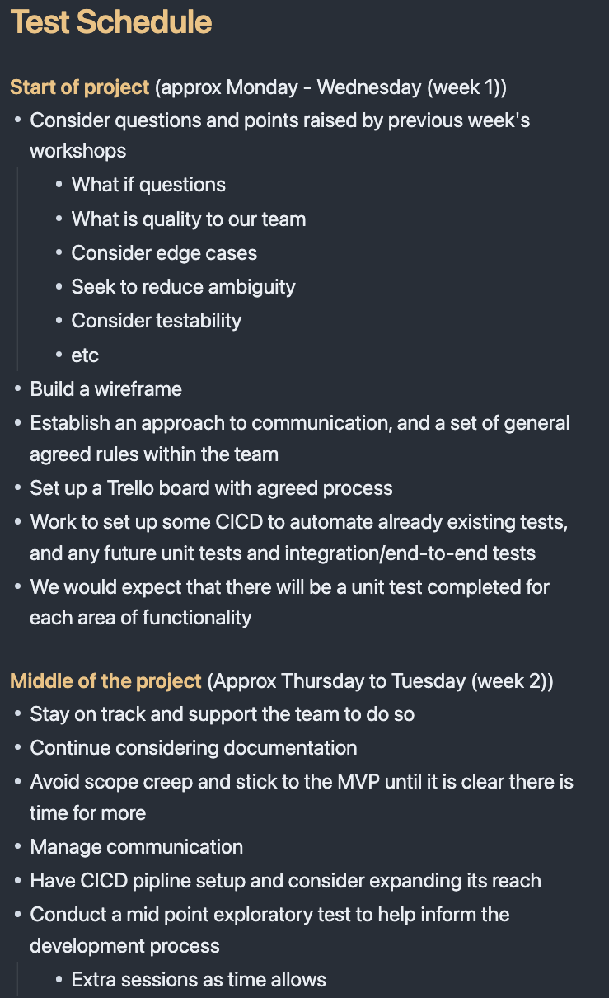
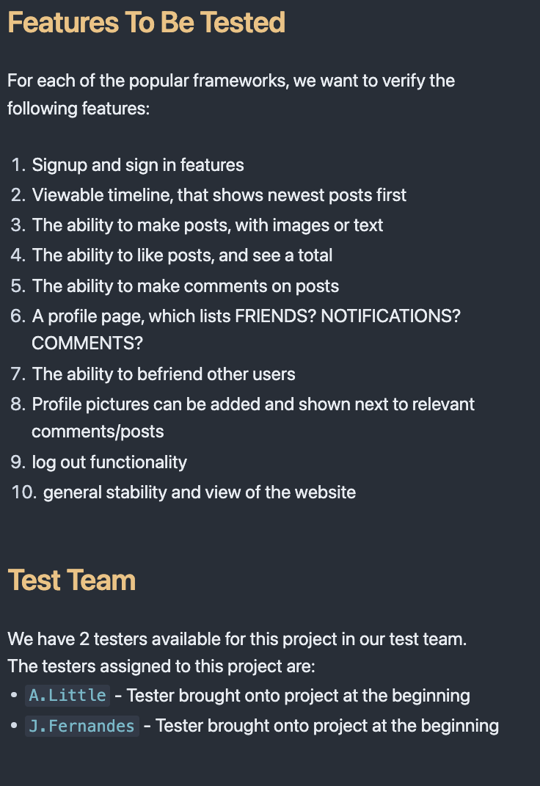
What did we test (and why)?
MVP features - as agreed by the team
Brief look at accessibility and security
Notes:
1. Signup and sign in features
2. Viewable timeline, that shows newest posts first
3. The ability to make posts, with images or text
4. The ability to like posts, and see a total
5. The ability to make comments on posts
6. A profile page, which lists FRIENDS? NOTIFICATIONS? COMMENTS?
7. The ability to befriend other users
8. Profile pictures can be added and shown next to relevant comments/posts
9. log out functionality
10. general stability and view of the website
These were the agreed upon features that are within the scope of testing. These features were prioritised as they mostly were within the MVP. This is only the first 2 weeks, or first sprint, of the project so testing of core features was the plan.
We have also lightly touched upon testing accessibility and security so that we can have a reference point for the future sprints. The main changes or improvements in these areas were somewhat out of scope for the developers, therefore we could not test them extensively.

Slide 7
How did we test it?
Accessibility and security testing - lighthouse, WAVE, ZAP →
Legacy and Dev Jest unit testing
Cypress for integration/end to end testing
CICD pipeline - with Github Actions
Exploratory tests - both ‘full’ and as features were pushed to Github

Slide 8
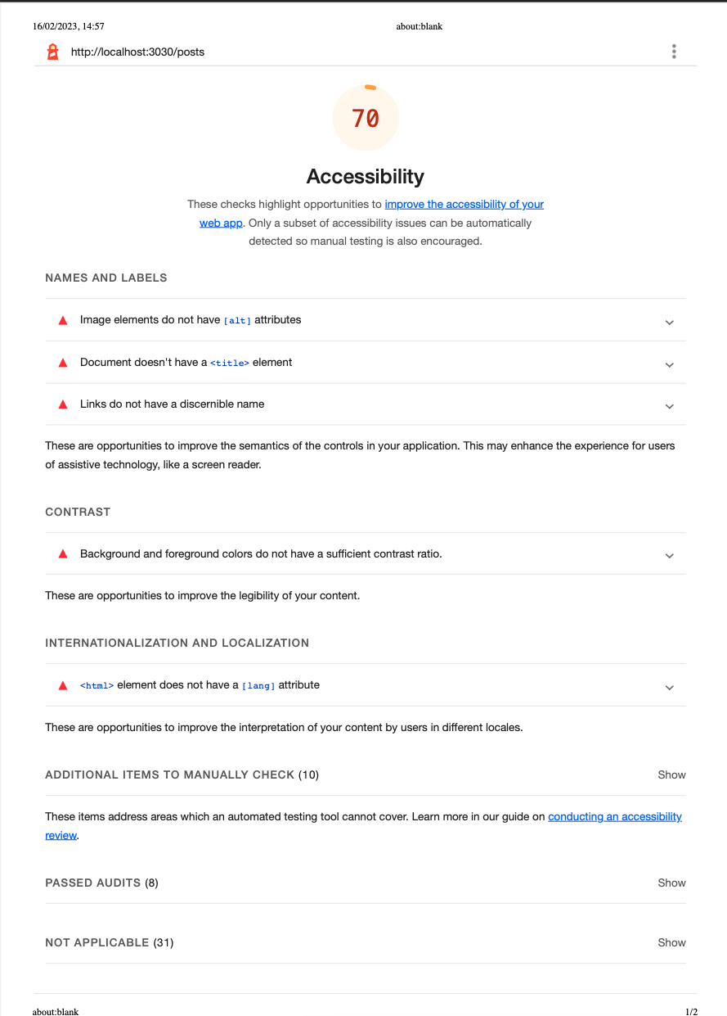
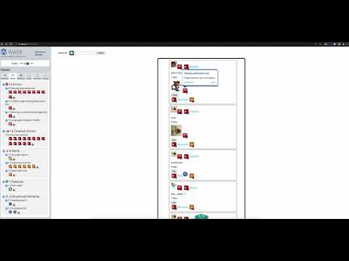
Accessibility examples:

Slide 9
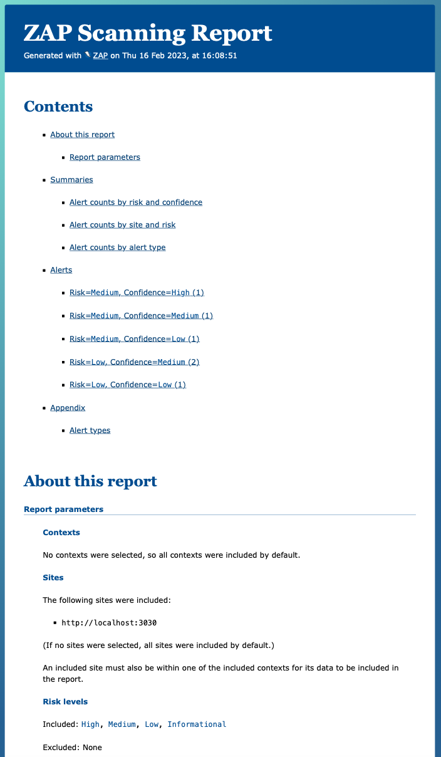
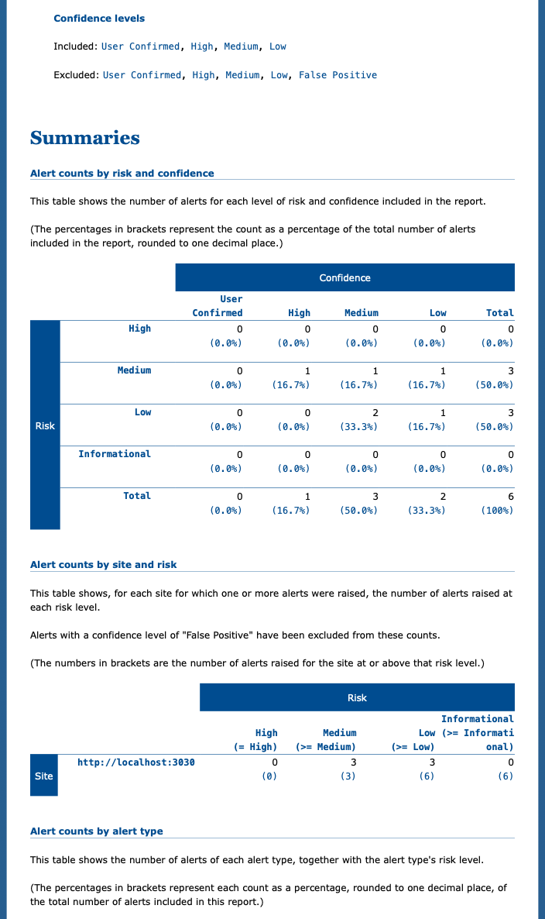

Slide 10
How did we test it?
Accessibility and security testing - lighthouse, WAVE, ZAP
Legacy and Dev Jest unit testing
Cypress for integration/end to end testing
CICD pipeline - with Github Actions
Exploratory tests - both ‘full’ and as features were pushed to Github

Slide 11
What procedures did we put in place to ensure the team was building with quality in mind?
First day meetings, Trello board setup, rules processes and agreements, initial diagram →
What is ‘Quality’ for our Devs and team
MVP establishment
Communication processes
Bug reporting (Trello) and feature maintenance (Github branches, slack, Trello)
CICD
Documentation

Slide 12
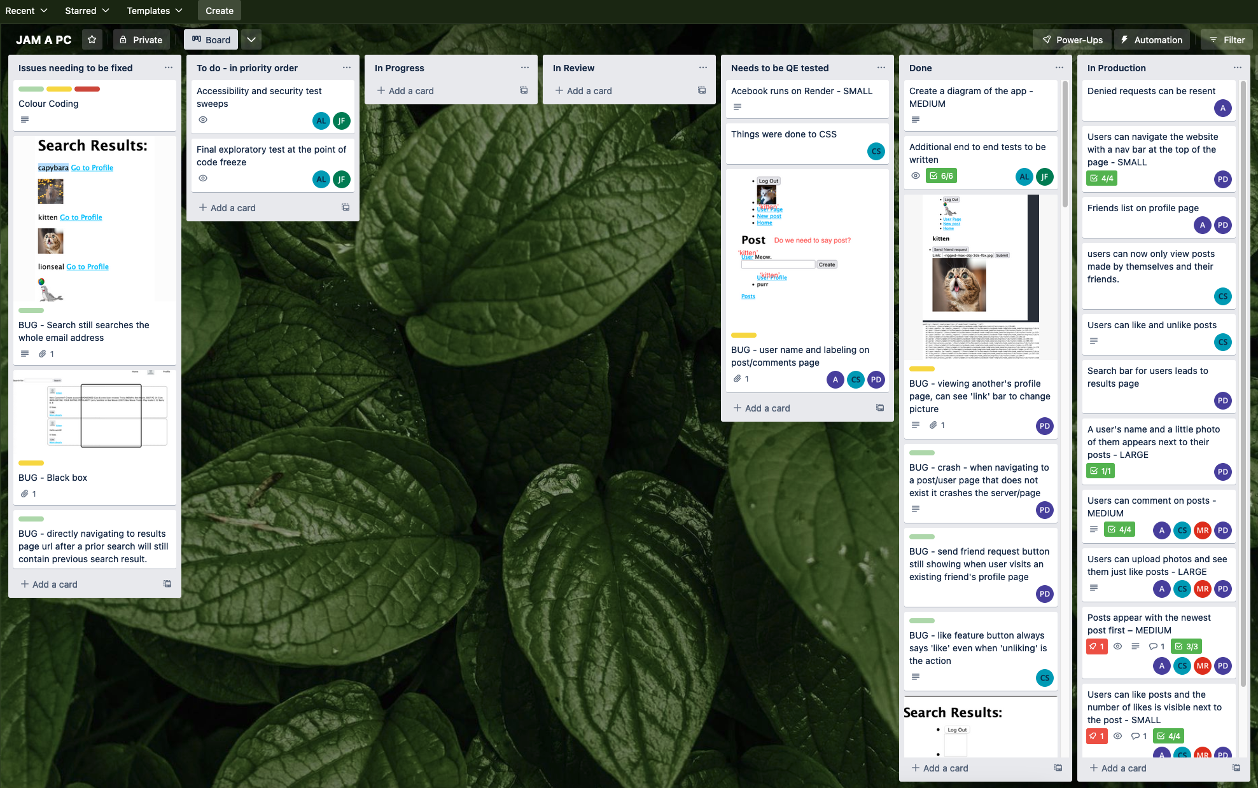

Slide 13
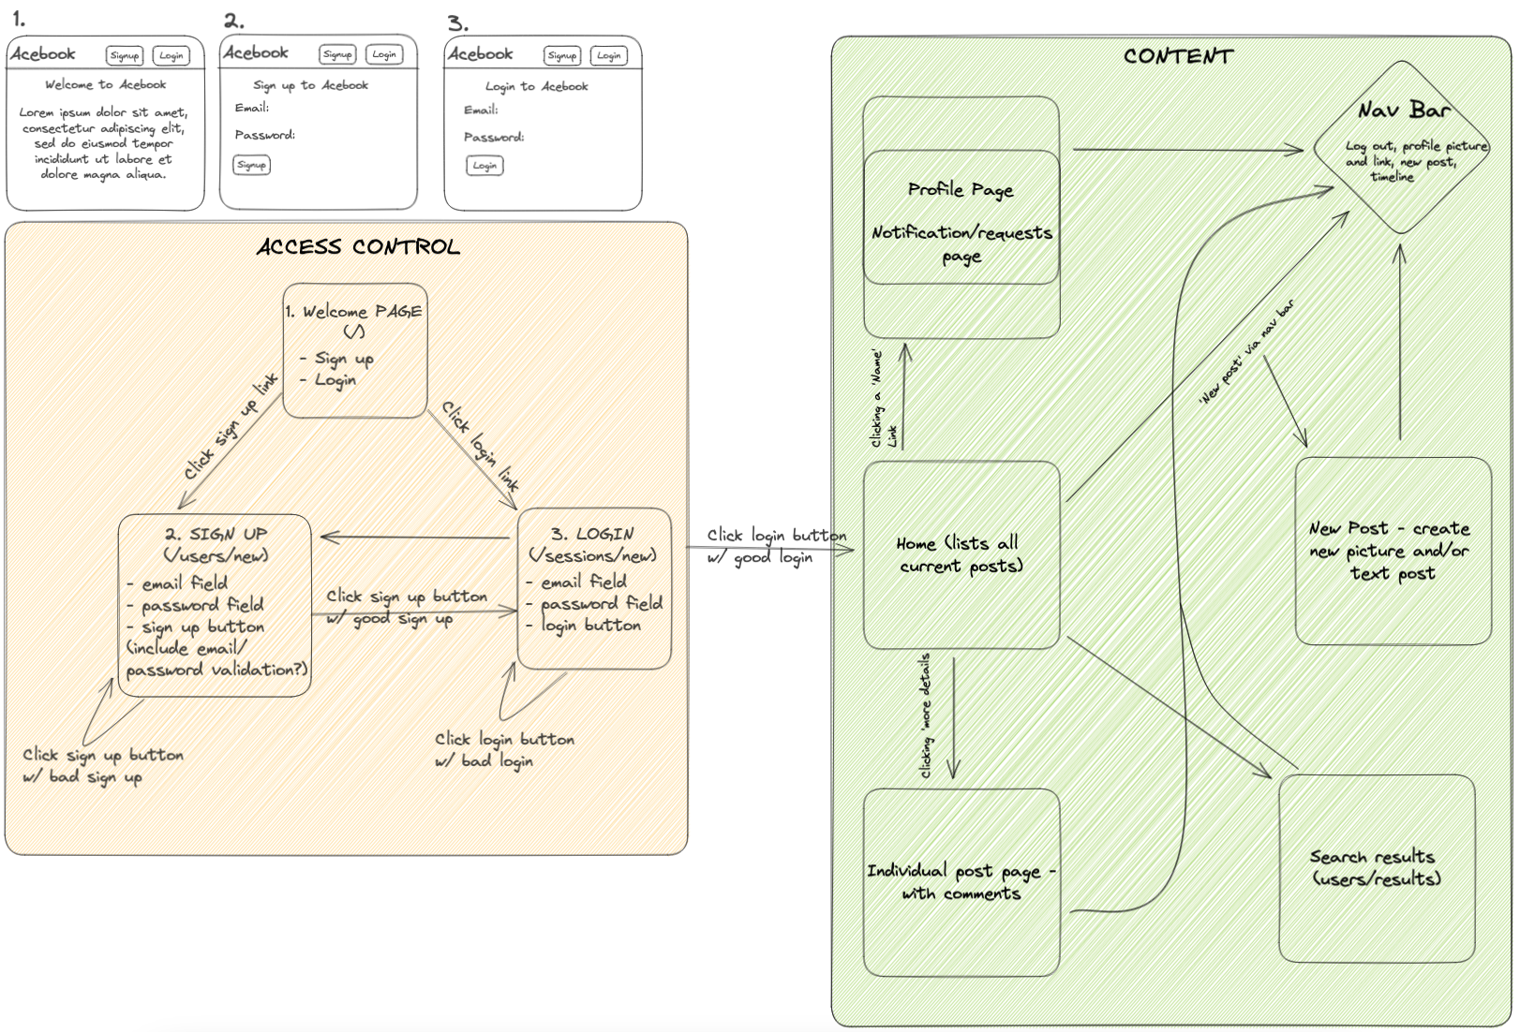

Slide 14
What procedures did we put in place to ensure the team was building with quality in mind?
First day meetings, Trello board setup, rules processes and agreements, initial wireframe diagram
What is ‘Quality’ for our Devs and team
MVP establishment
Communication processes
Bug reporting (Trello) and feature maintenance (Github branches, slack, Trello)
CICD
Documentation

Slide 15
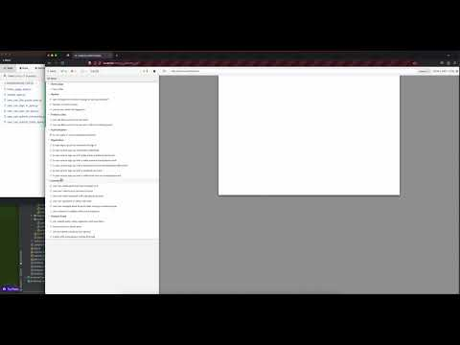
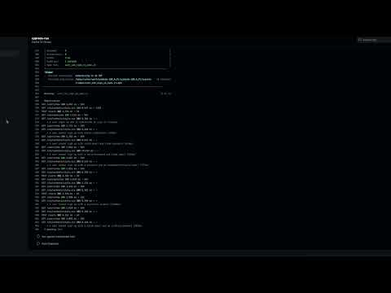
What did we automate (and why)?
CICD - using Cypress, Github Actions and Render with Atlas MongoDB

Slide 16
What have we learnt?
Importance of having a team understanding of process, communication streams, priorities and concept
We can work with new technologies that we have no previous experience of
Experience of adding quality to the Dev’s work throughout the first sprint
Exploratory testing’s value
When testing, using clear and unique usernames, for example, makes it easier to mentally process and communicate to others

Slide 17
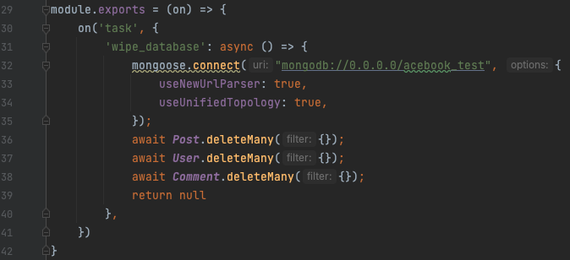
What obstacles did we encounter?
CI process
CD process
Cypress and cy.tasks and database wiping
New technologies

Slide 18
What would we do differently if we did it again?
Bearing in mind this is the first 2 week sprint
Consider in more detail the order of features to be produced - eg - navbar
Less focus on end to end in the first 2 weeks - new features being pushed regularly
Be more clear around how we feel branches should be used
Consider providing more support to devs in writing their unit tests
We were happy to find we could understand some JavaScript, but perhaps dedicating some time to learning more about it would have benefited

Slide 19
Questions?

Slide 20
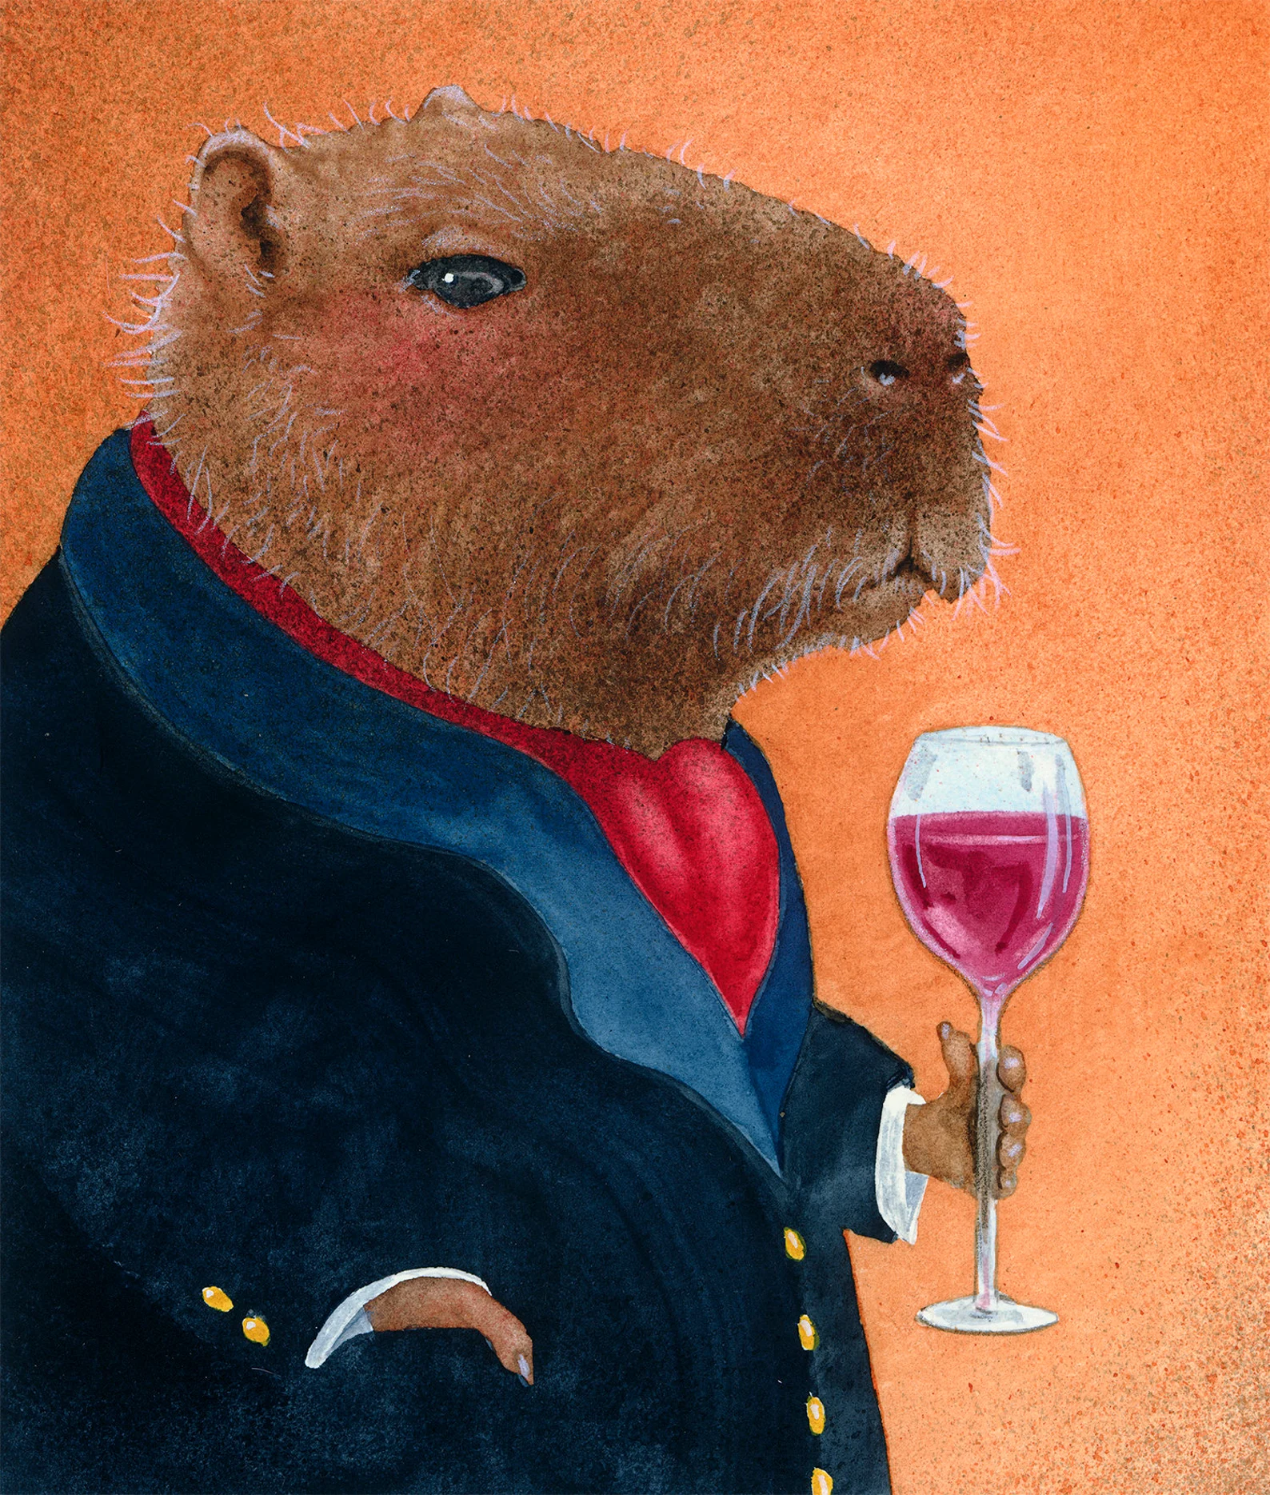
I knew you would ask that…

Slide 21
What would we look to focus on in the next sprint
Meeting to discuss with the Dev’s what the new priorities should be, what new features should be added next
A greater focus on design and usability
Further browser testing, mobile testing
Increased focus on accessibility and security
Adding to test suite once new features are completed

